Slide 1
Java Persistence API

Slide 2
Objectives
Explain what JPA is and its role in data persistence for Java applications.
Highlight the advantages of using JPA over traditional JDBC approaches.
Define and illustrate core JPA concepts like entities, annotations, persistence context, entity manager and JPQL.
Provide a clear understanding of how these components work together to manage data.
Show how JPA simplifies development by reducing boilerplate code and allowing focus on business logic.

Slide 3
Contents
Introduction
Key Concepts
Annotations
Relationships
Using JPA
Demo
Advantages and Disadvantages

Slide 4
Object Relational Mapping (ORM)

Slide 5
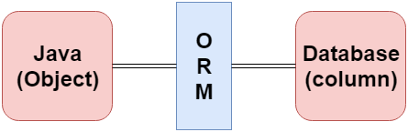
JPA Object Relational Mapping
ORM makes it easier to work with databases in object-oriented applications, allowing you to focus on the business logic rather than the underlying data storage details.

Slide 6
Benefits of ORM
Increased Productivity: You write less code because ORM handles the low-level data access tasks.
Improved Maintainability: Your code is cleaner and easier to understand because it focuses on the business logic, not database details.
Enhanced Performance: ORM frameworks can optimize data access and caching, potentially improving performance.
Database Independence: You can switch databases without rewriting your application code (to some extent)

Slide 7
Popular ORM Frameworks for Java
Hibernate: The most widely used JPA implementation, offering a rich feature set and extensive customization options.
EclipseLink: Another JPA implementation with a focus on standards compliance and portability.
Spring Data JPA: An abstraction layer on top of JPA providers, simplifying data access and reducing boilerplate code.
DataNucleus providing easy persistence to RDBMS datastores. Comes with its own "SQL-like" JPQL query language, so you query your data in a language similar to what your datastore understands.

Slide 8
Java Persistence API (JPA)

Slide 9
JPA Versions and Key Features
JPA Version | Release Year | Key Features
JPA 1.0 | 2006 | Core ORM functionality: entities, mappings, relationships, inheritance, JPQL, EntityManager
JPA 2.0 | 2009 | Enums, Criteria API, embeddable collections, derived properties, validation, metamodel
JPA 2.1 | 2013 | Entity graphs, converters, stored procedures, Java 8 date/time
JPA 2.2 | 2019 | Streamlined bootstrap, Java 9 modules
JPA 3.0 | 2022 | Renamed to Jakarta Persistence, Java records, Java 17 support

Slide 10
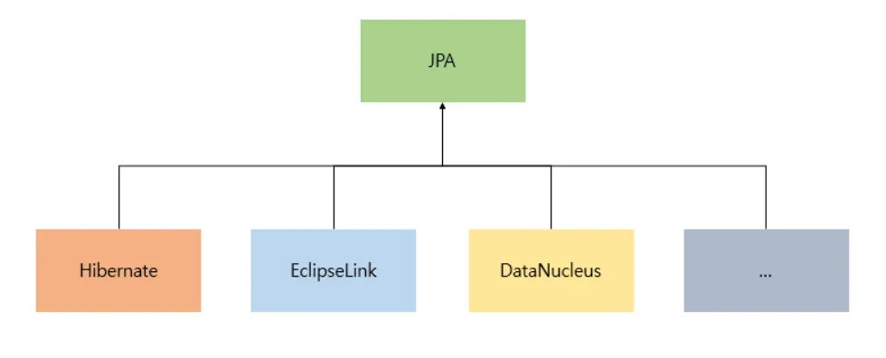
JPA Implementation Options

Slide 11
What is JPA ?
JPA stands for Java Persistence API. It is a Java programming interface that allows developers to manage relational data in Java applications using object oriented methodologies.
JPA is a specification for managing relational data in Java applications. It provides a set of interfaces, annotations, and an object relational mapping (ORM) framework that simplifies the process of interacting with databases.

Slide 12
Key Feature of JPA
ORM: JPA allows you to map Java objects (entities) to relational database tables, abstracting away the differences between the object-oriented and relational models.
Annotations: You can use annotations to define entities, relationships and other persistence related metadata.
EntityManager: The interface provides methods for persisting, retrieving, updating, and deleting entities.
JPQL is an object oriented query language that allows you to query entities and their relationships.
Transaction Management: JPA supports transaction management, ensuring data integrity and consistency.

Slide 13
Benefits of Using JPA
Simplified Data Access: JPA makes it easier to work with relational data in Java applications by providing a higher-level abstraction.
Code Portability: JPA is a standard specification, so code written using JPA can be portable across different JPA providers.
Reduced Boilerplate Code: JPA annotations and the EntityManager interface reduce the amount of code needed for data access.
Improved Data Integrity: JPA's transaction management and validation features help ensure data integrity.
Enhanced Performance: Caching and other optimization techniques can improve the performance of JPA applications.

Slide 14
Entity Annotations in JPA
@Entity: This annotation marks a Java class as an entity, meaning it represents a table in the database.
@Table: This annotation allows you to specify the name of the database table that an entity maps to.
@Transient: This annotation marks a property that should not be persisted to the database.
@NamedQueries and @NamedQuery: These annotations allow you to define named queries that can be used to retrieve entities.

Slide 15
Mapping Annotations in JPA
@Id: This annotation marks a Java class as an entity, meaning it represents a table in the database.
@Column: This annotation defines the mapping between a property of an entity and a column in the database table. You can use it to specify the column name, data type, and other attributes.
@Basic: This annotation specifies that a property is a basic type and should be persisted.
@Enumerated: This annotation is used to map an Enum type to a database column.

Slide 16
JPA Entity Manager
The entity manager implements the API and encapsulates all of them within a single interface.
Manages entity lifecycle: Persist, find, merge, remove
Controls persistence context: Cache, flush, detach
Executes queries: JPQL, Criteria API
Handles transactions: Begin, commit, rollback
Provides access to entity metadata

Slide 17
Key Operations of the Entity Manager
Persisting Entities: em.persist(entity) makes a transient entity instance persistent
Finding Entities: em.find(entityClass,primaryKey) retrieves an entity by its primary key.
Merging Entities: em.merge(entity) merges a detached entity instance into the current persistence context.
Removing Entities: em.remove(entity) removes a persistent entity instance.
Querying Data: em.createQuery(jpqlString) creates a JPQL query to retrieve entities based on specified criteria.

Slide 18
Demo Simple CRUD with JPA

Slide 19
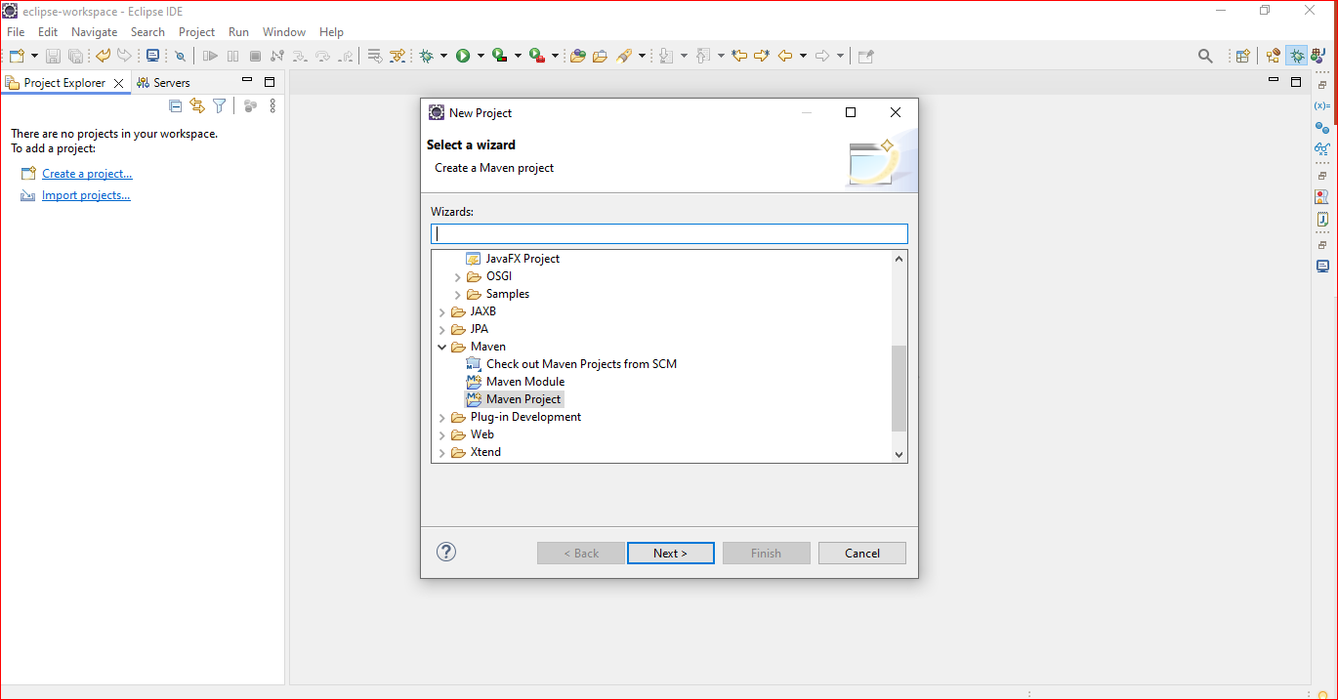
1. Open Eclipse, File | New | Maven Project

Slide 20
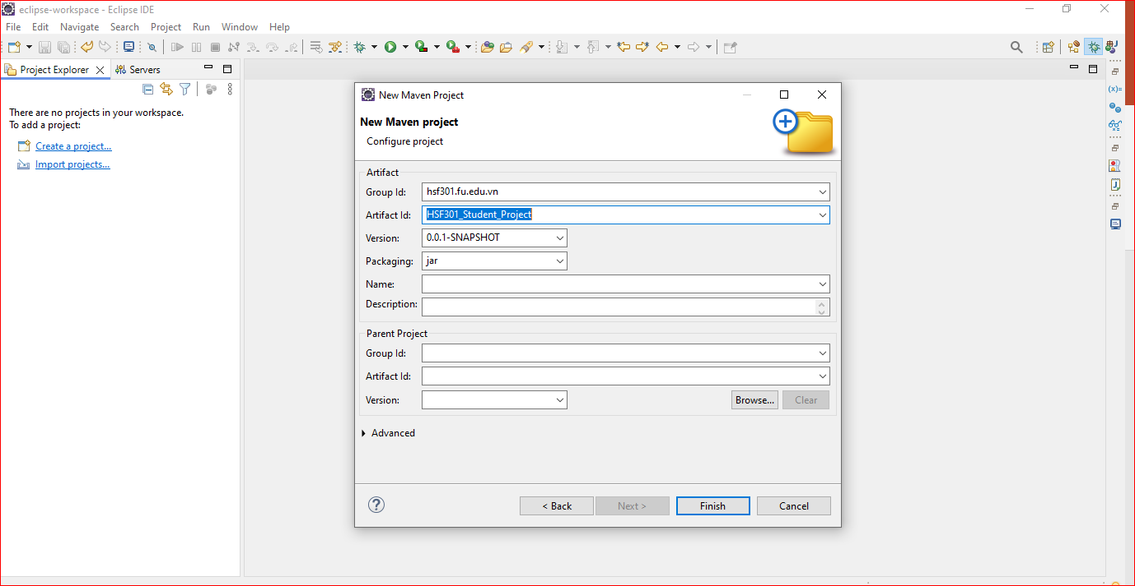
2. Check Create a simple project -> Browse Project -> Next

Slide 21
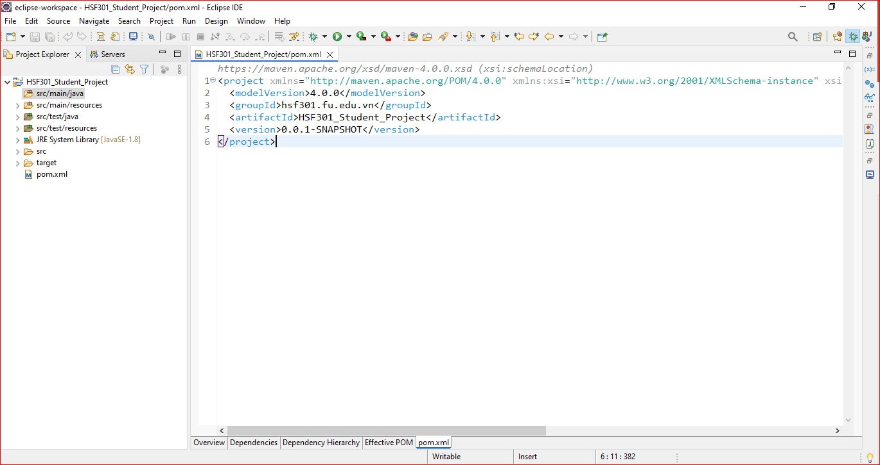
3. The New Project

Slide 22
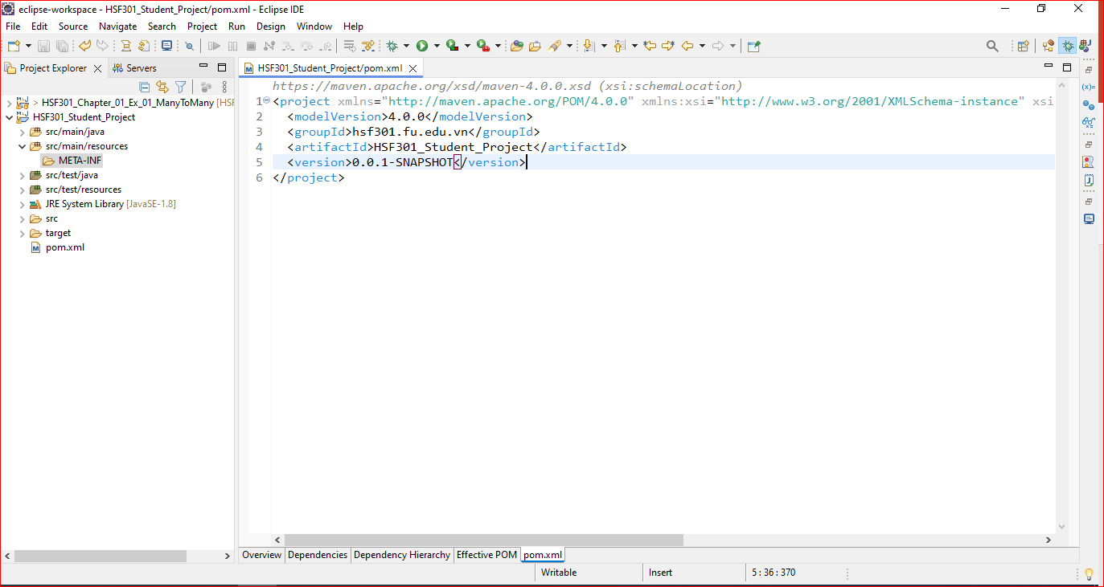
4. Create folder META-INF in src/main/resources

Slide 23
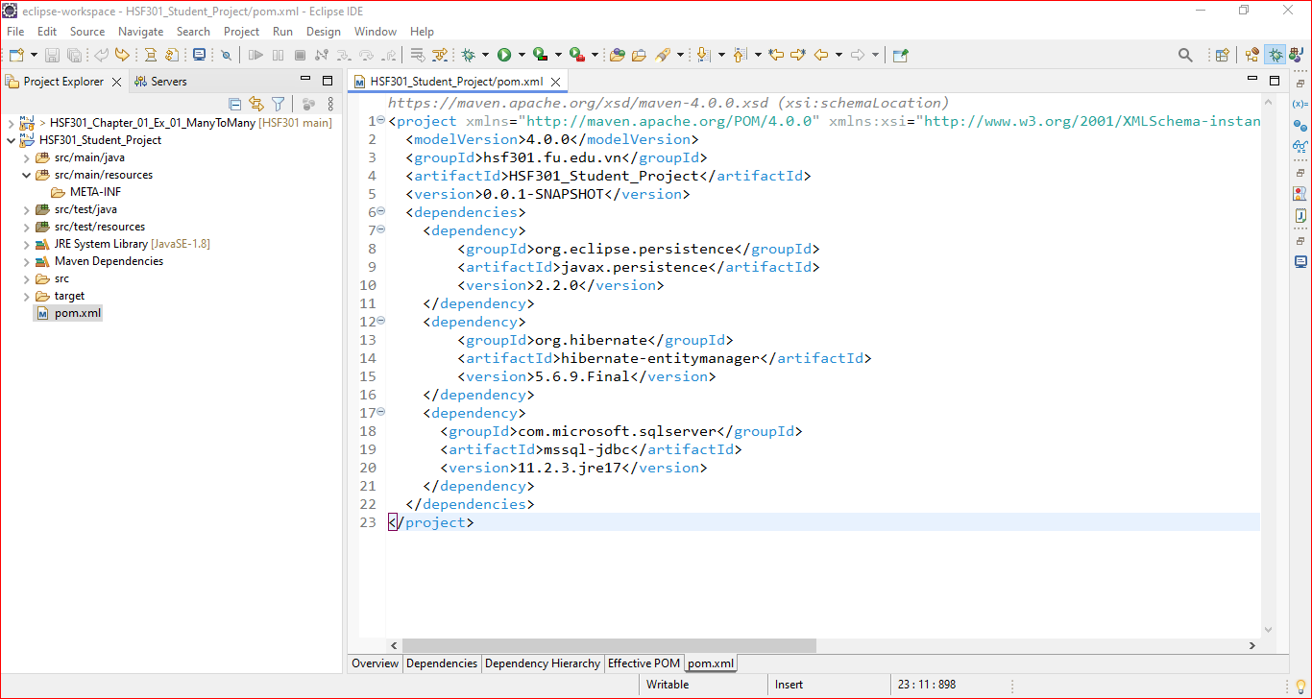
5. Edit the pom.xml

Slide 24
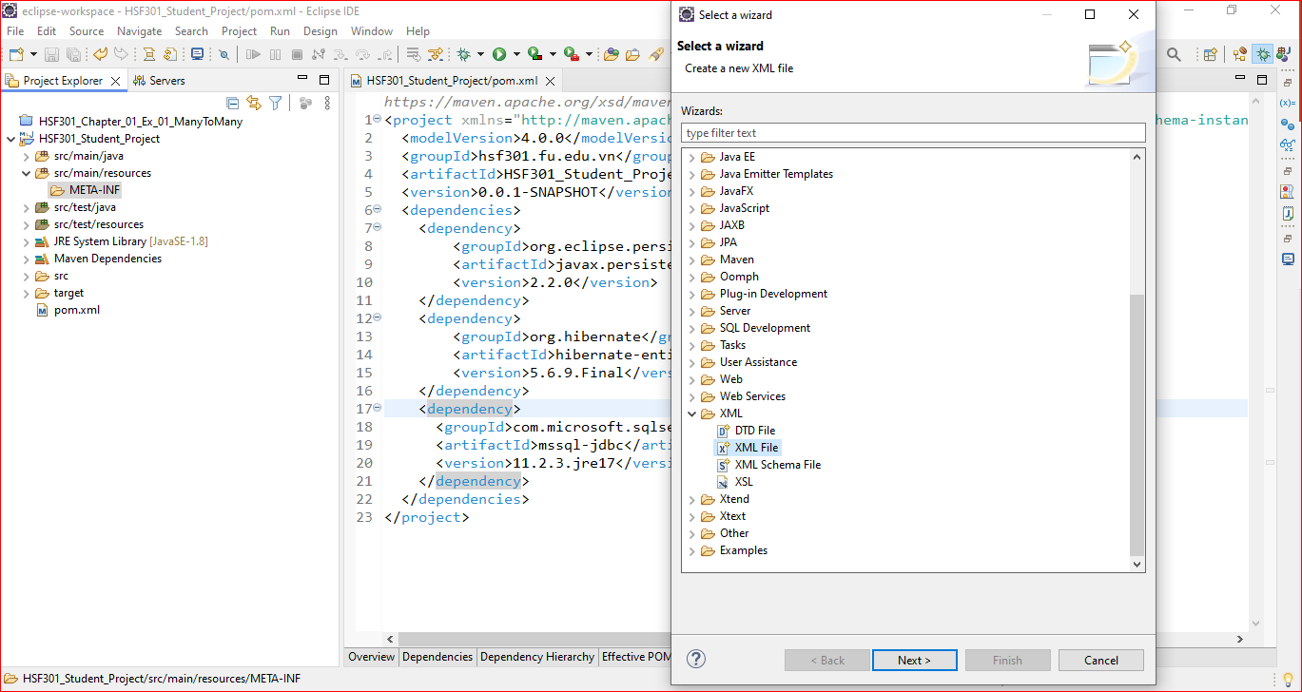
6. Create persistence.xml in META-INF folder

Slide 25
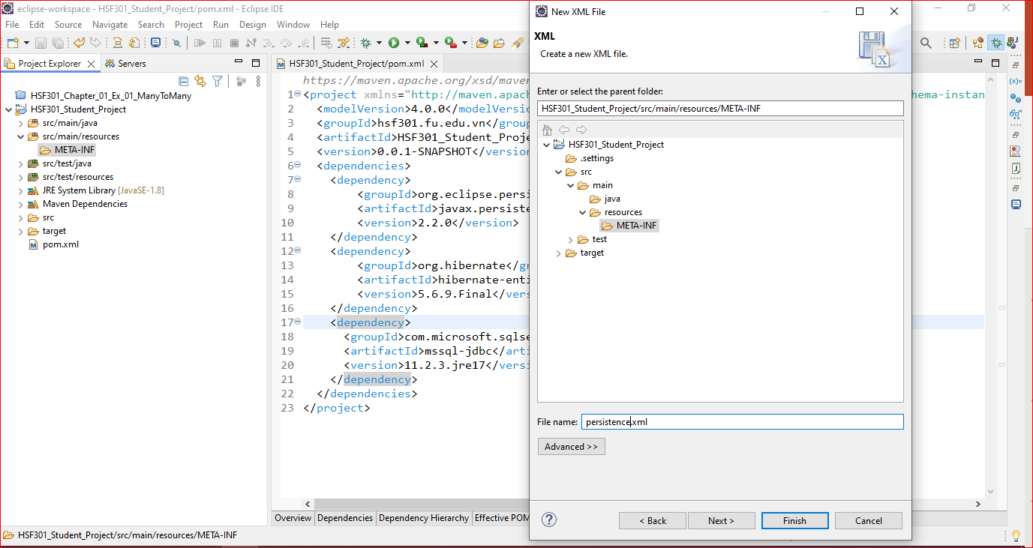
7. Create persistence.xml in META-INF folder

Slide 26
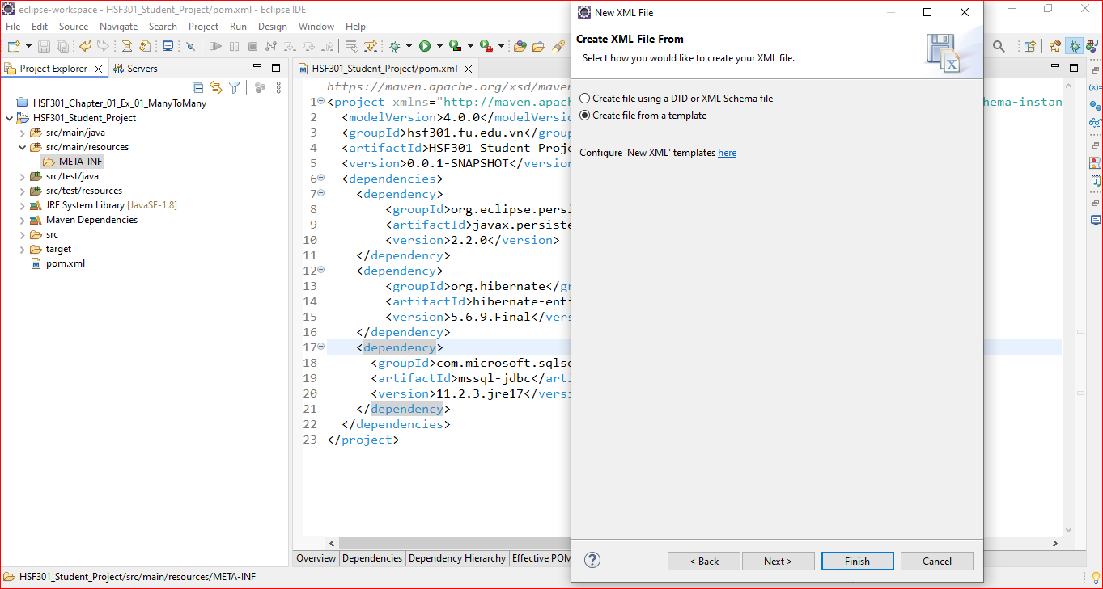
8. Create persistence.xml in META-INF folder

Slide 27
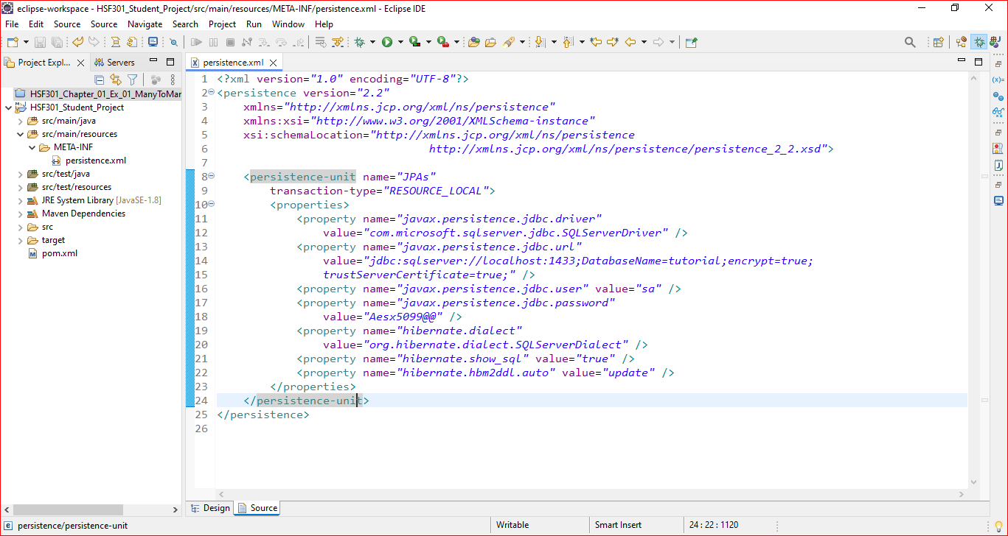
9. Edit the persistence.xml in META-INF folder

Slide 28
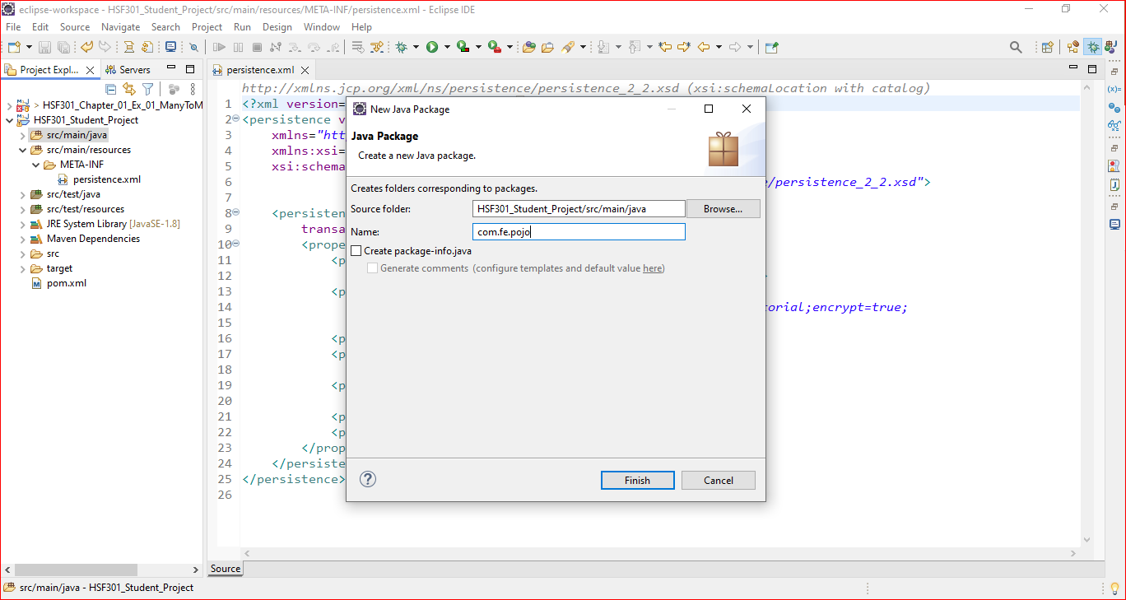
10. Add com.fe.pojo Package in src/main/java

Slide 29
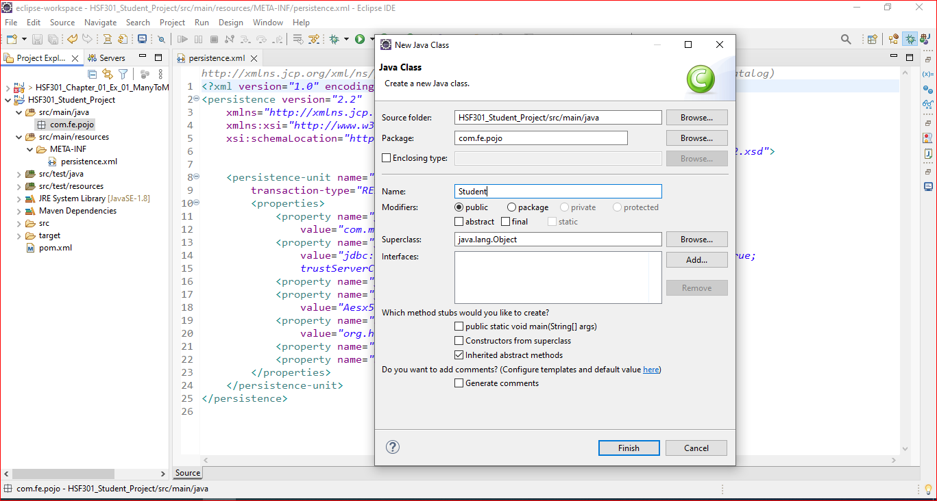
11. Add Student.java in com.fe.pojo package

Slide 30
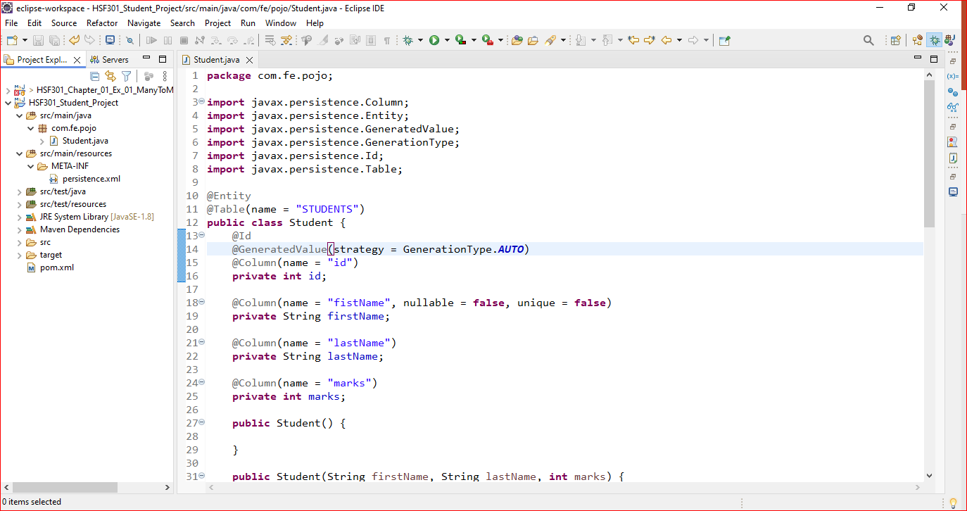
12. Edit the Student.java

Slide 31
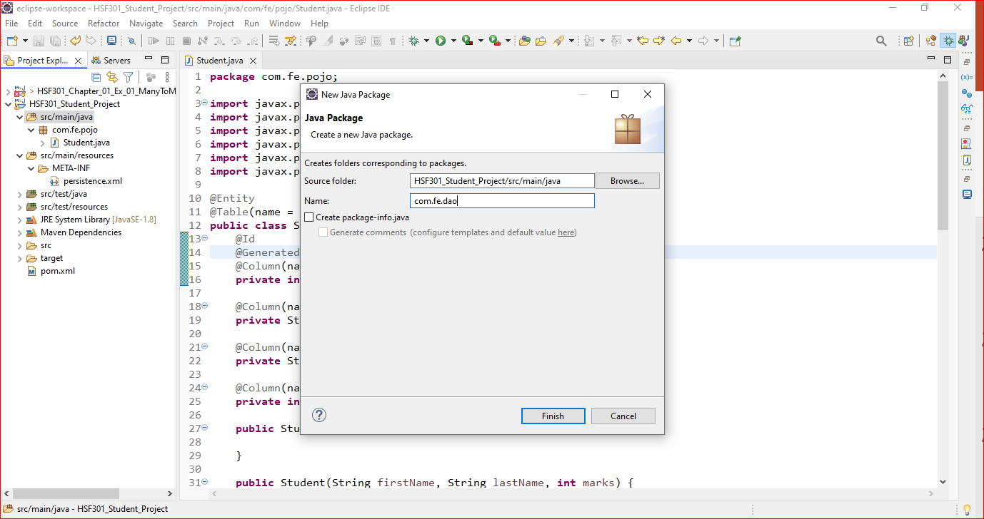
13. Add com.fe.dao Package in src/main/java

Slide 32
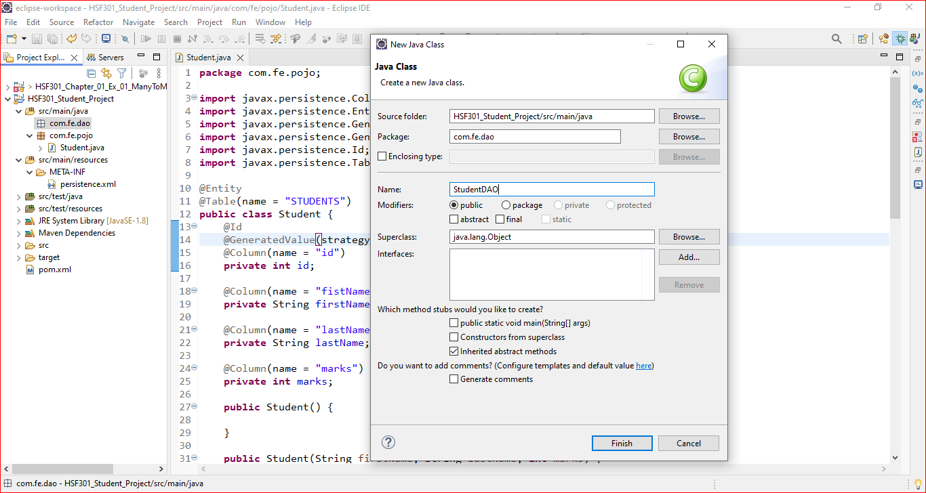
14. Create StudentDAO in com.fe.dao

Slide 33
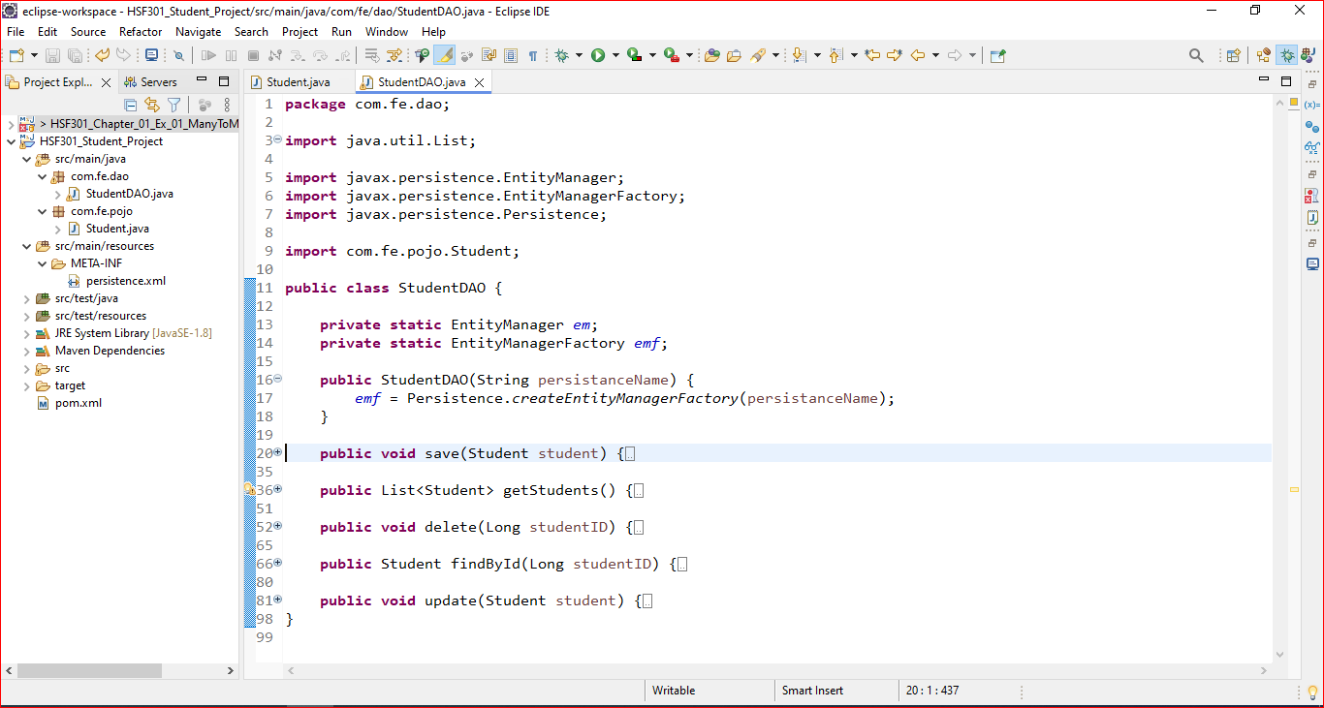
15. Edit the StudentDAO in com.fe.dao

Slide 34
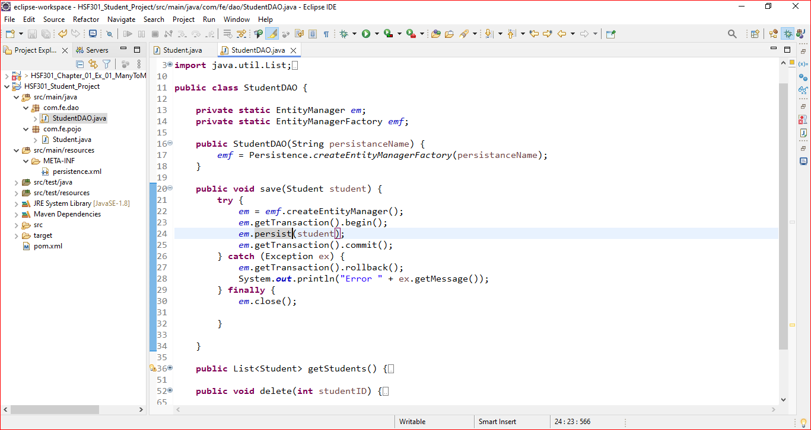
16. Save Student Method

Slide 35
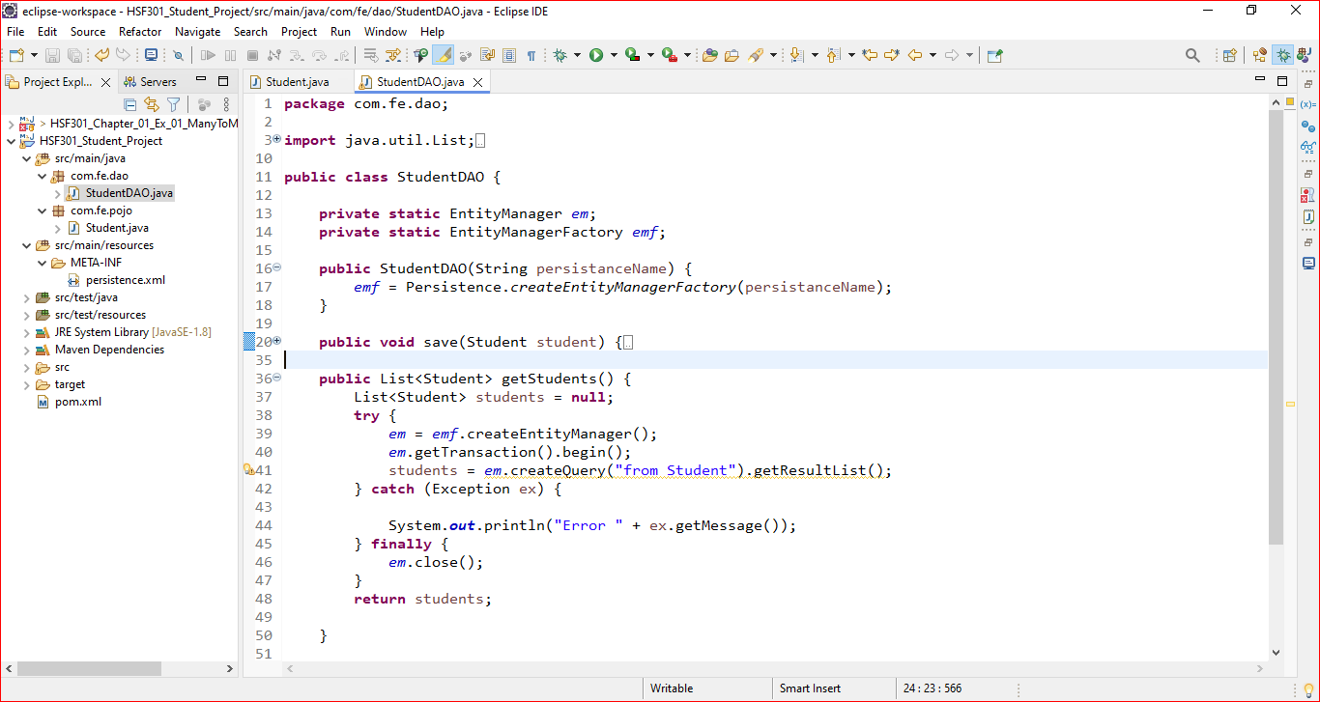
17. Get All Students Method

Slide 36
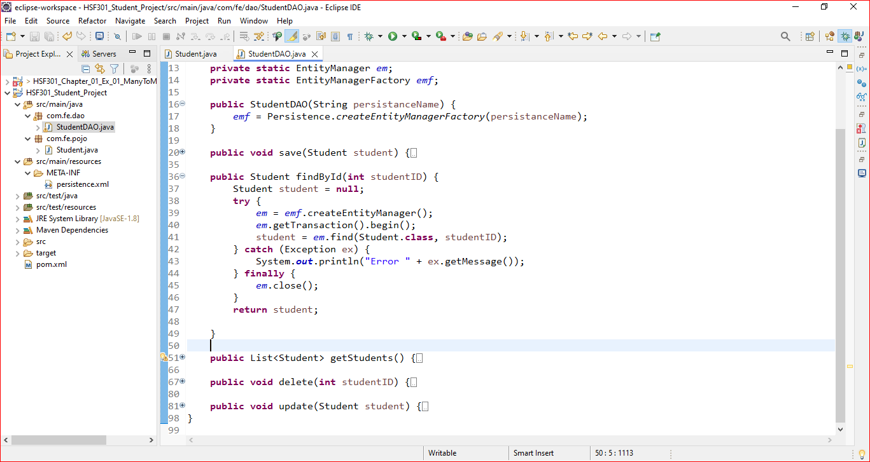
18. Find a Student Method

Slide 37
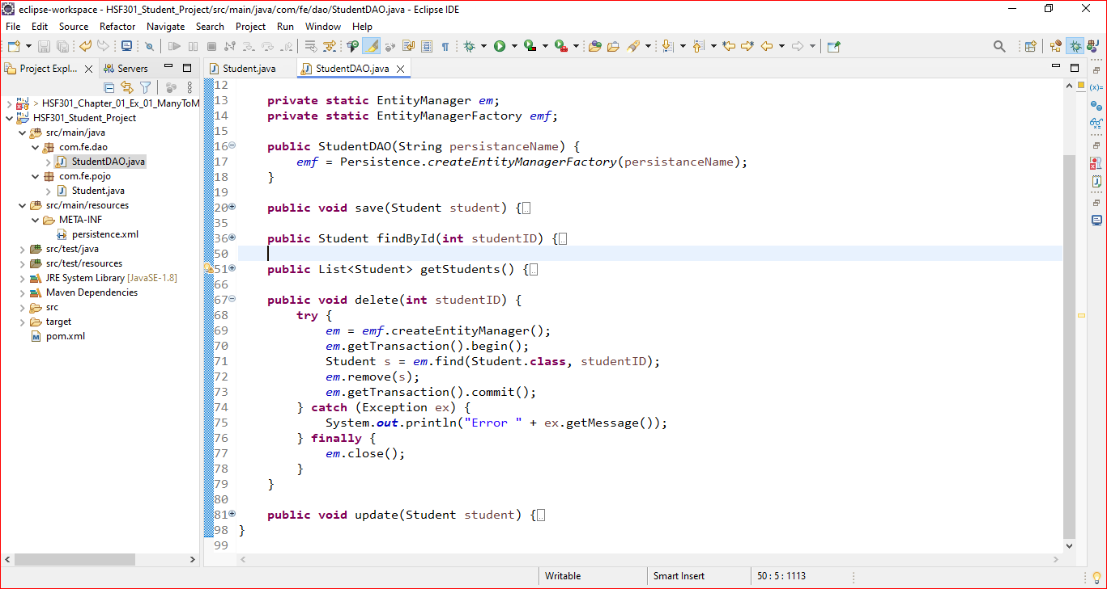
19. Delete Student Method

Slide 38
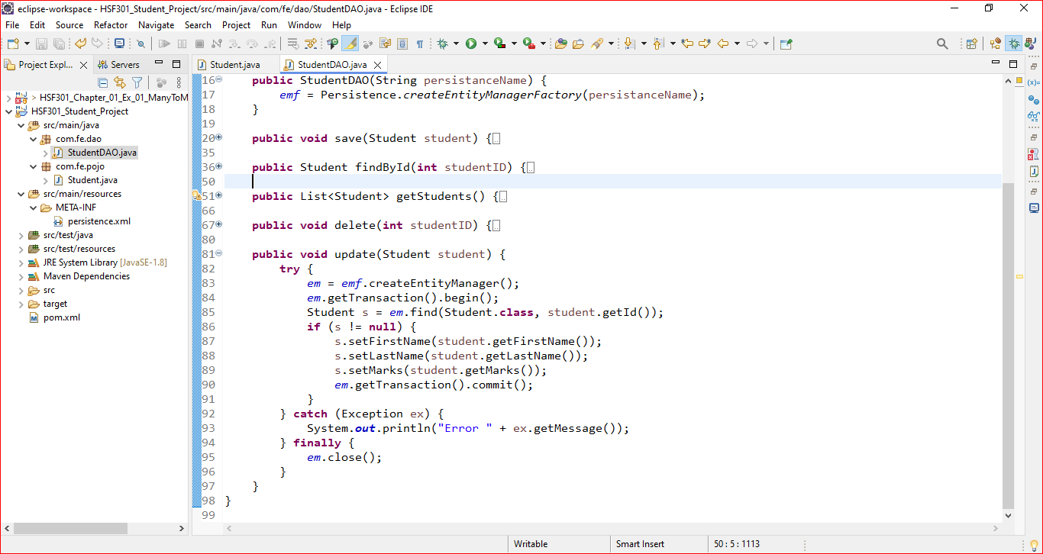
20. Update Student Method

Slide 39
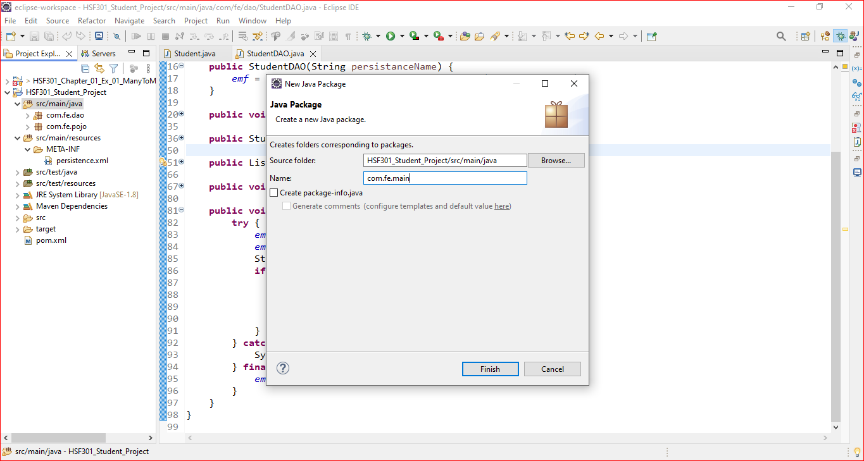
21. Add com.fe.main Package in src/main/java

Slide 40
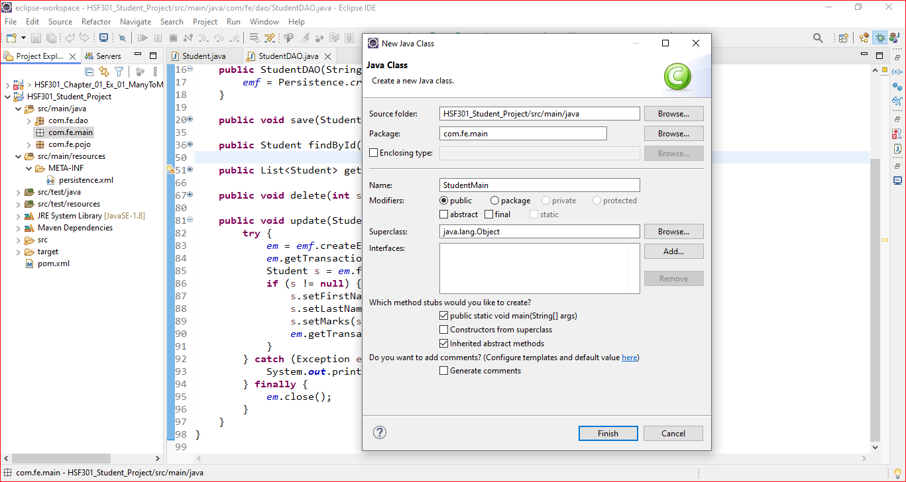
22. Create StudentMain class in com.fe.main Package

Slide 41
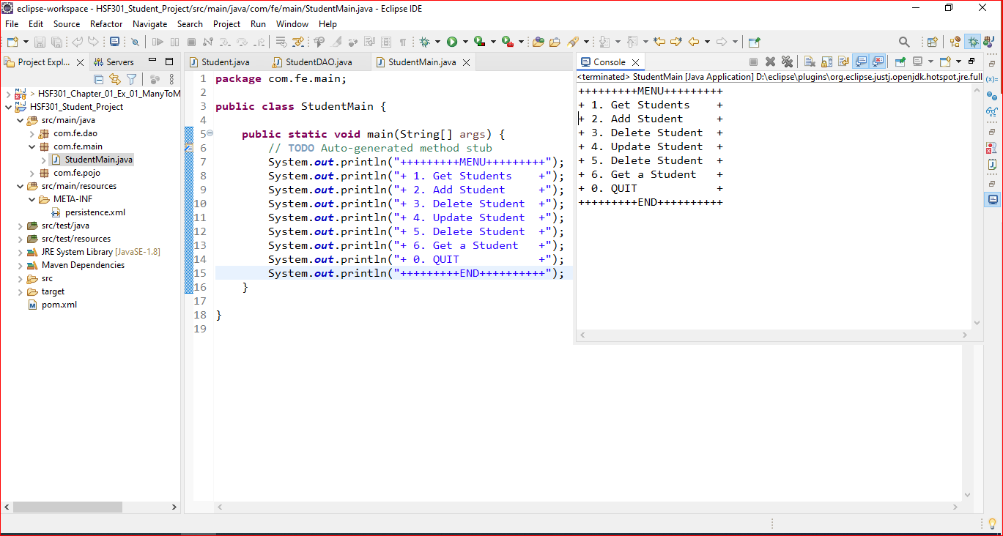
23. Edit the StudentMain in com.fe.main

Slide 42
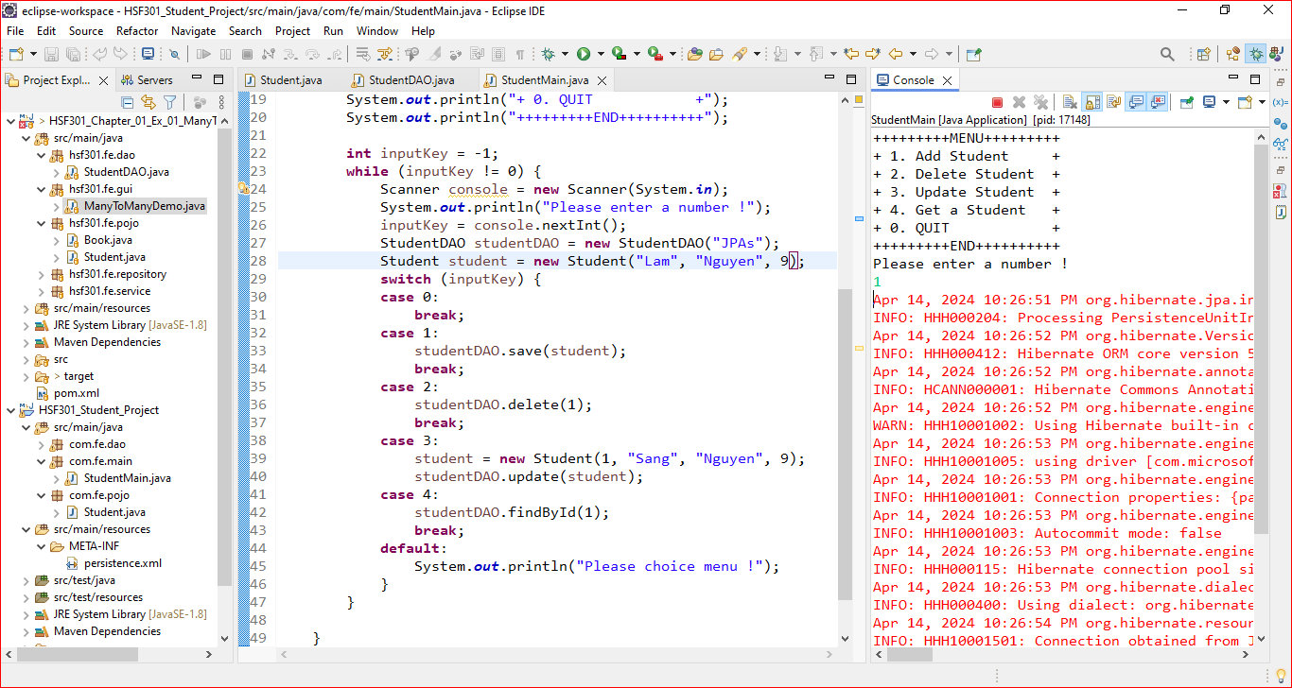
24. Edit the StudentMain in com.fe.main

Slide 43
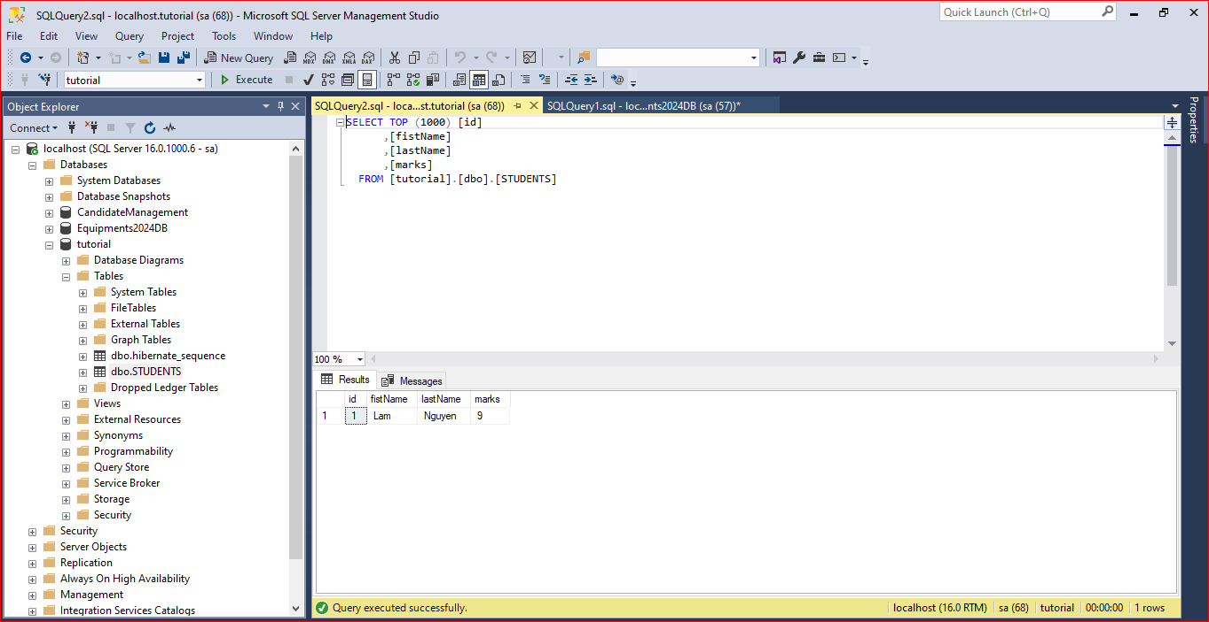
25. Result

Slide 44
Mapping in JPA

Slide 45
Relationships Annotations in JPA
@ManyToOne: This annotation defines a many-to-one relationship between two entities.
@OneToMany: This annotation defines a one-to-many relationship between two entities.
@OneToOne: This annotation defines a one-to-one relationship between two entities.
@ManyToMany: This annotation defines a many-to-many relationship between two entities.

Slide 46
Demo JPA (One To Many)

Slide 47
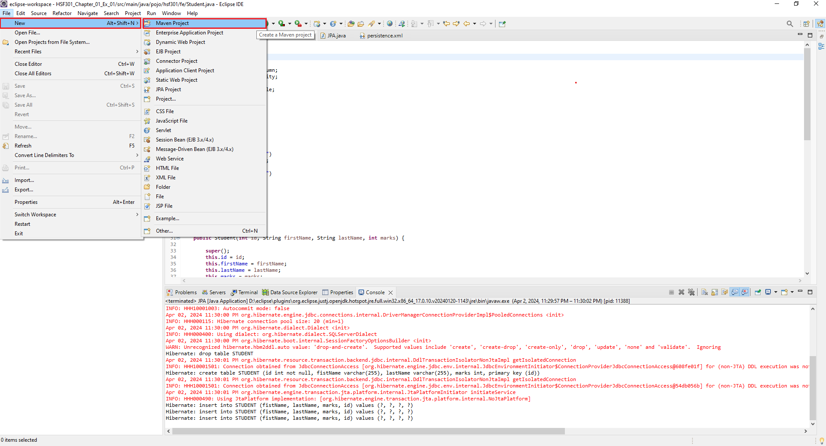
1. Open Eclipse, File | New | Maven Project

Slide 48
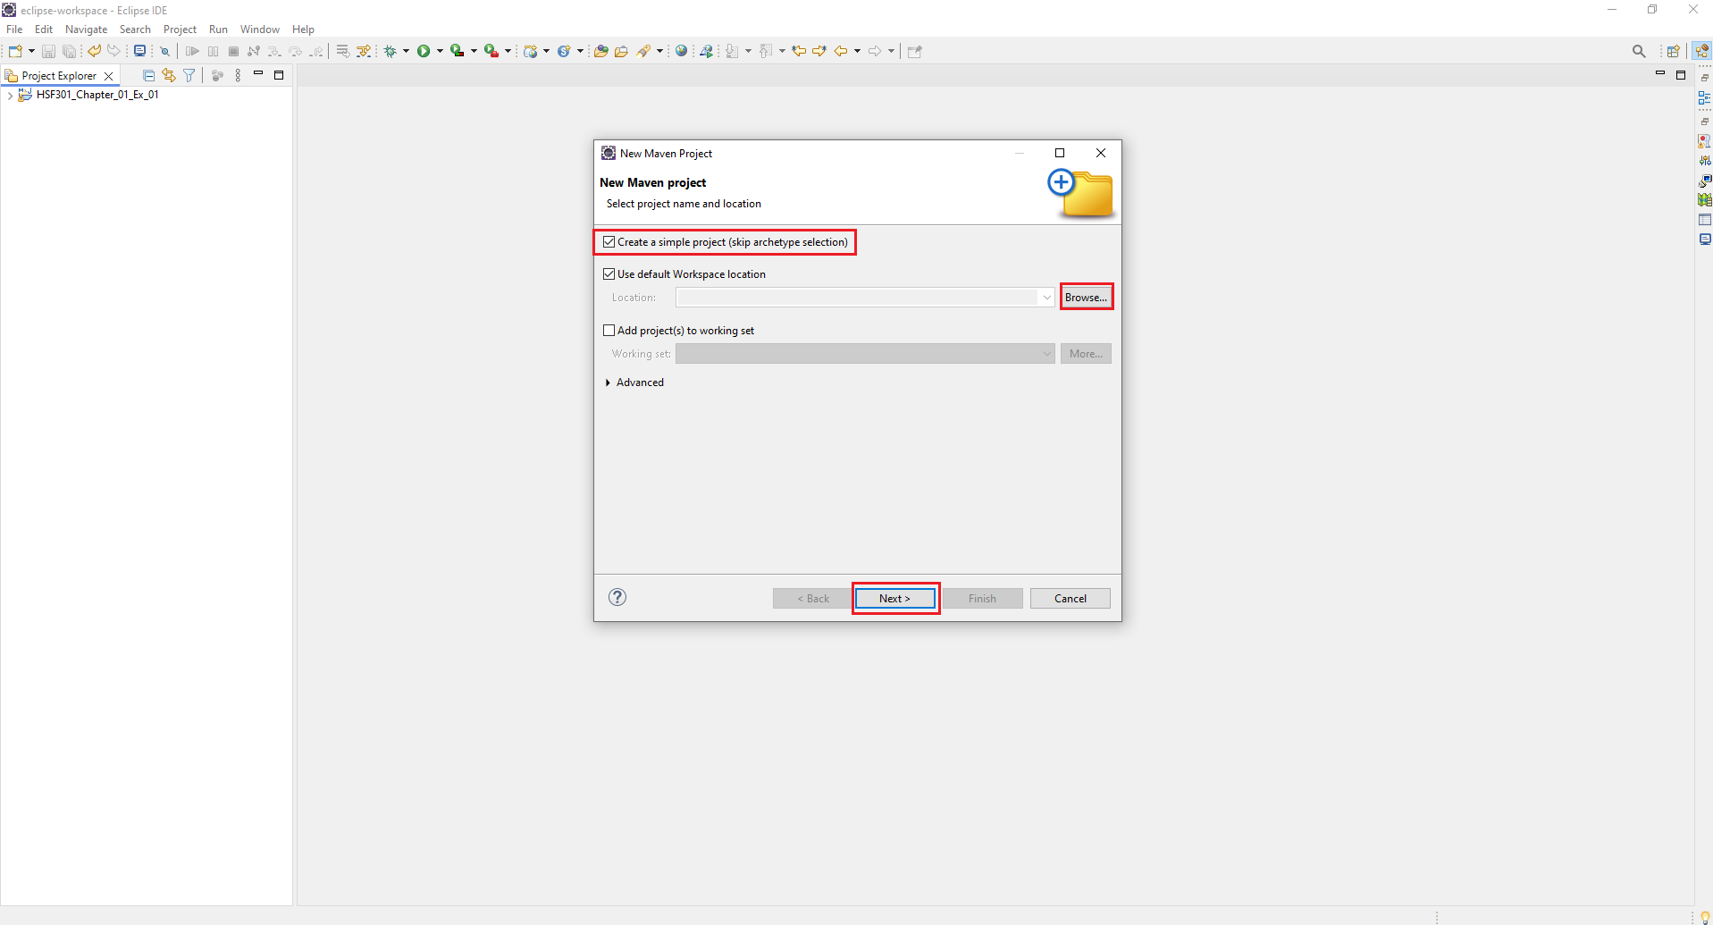
2. Check Create a simple project -> Browse Project -> Next

Slide 49
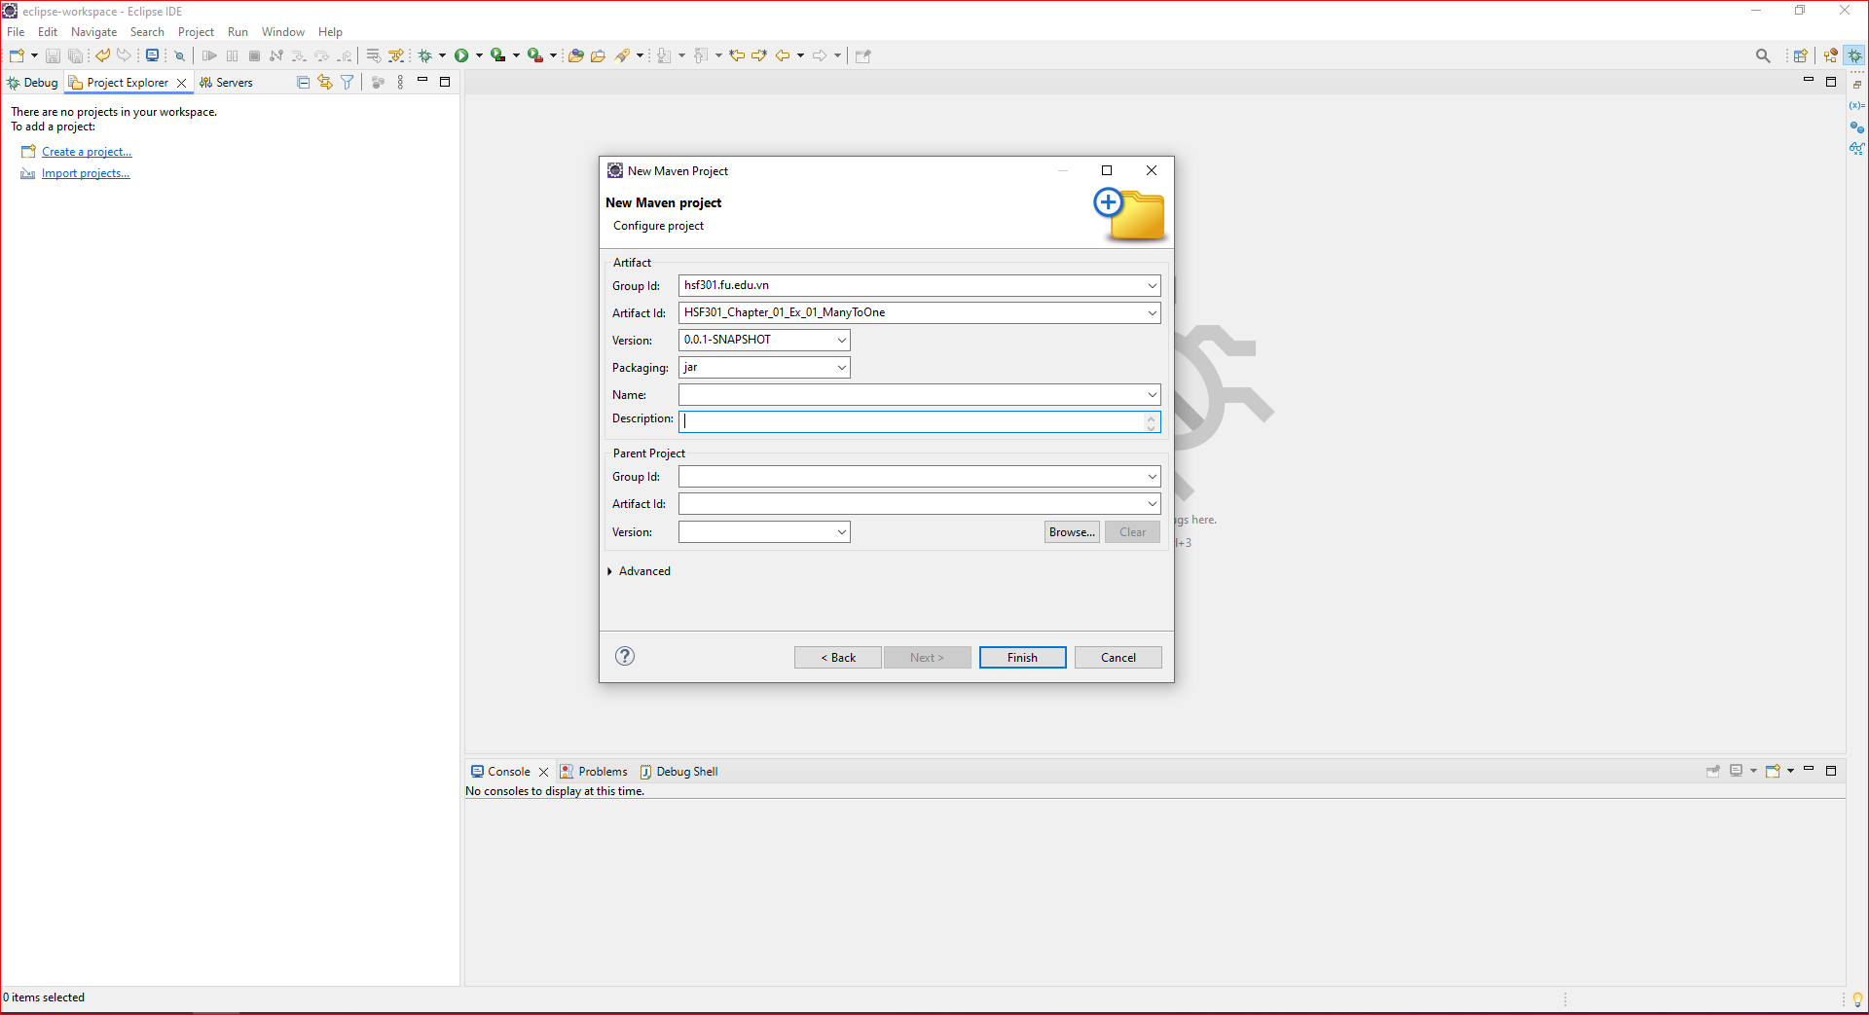
3. Fill the information Project -> Click Finish

Slide 50
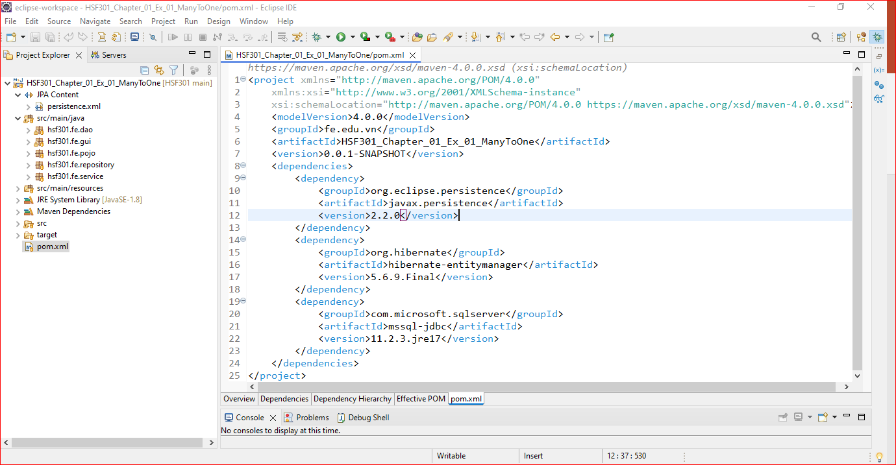
4. Structure of Maven Project
1
Edit the content of pom.xml

Slide 51
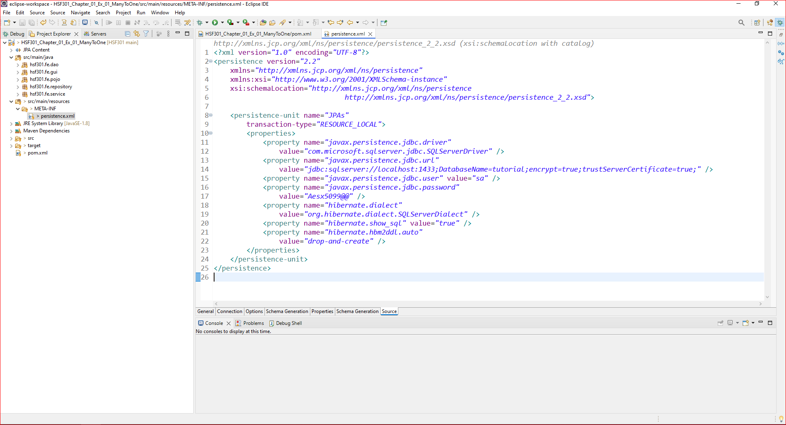
5. Create persistence.xml in META-INF folder

Slide 52
6. Create structure of project

Slide 53
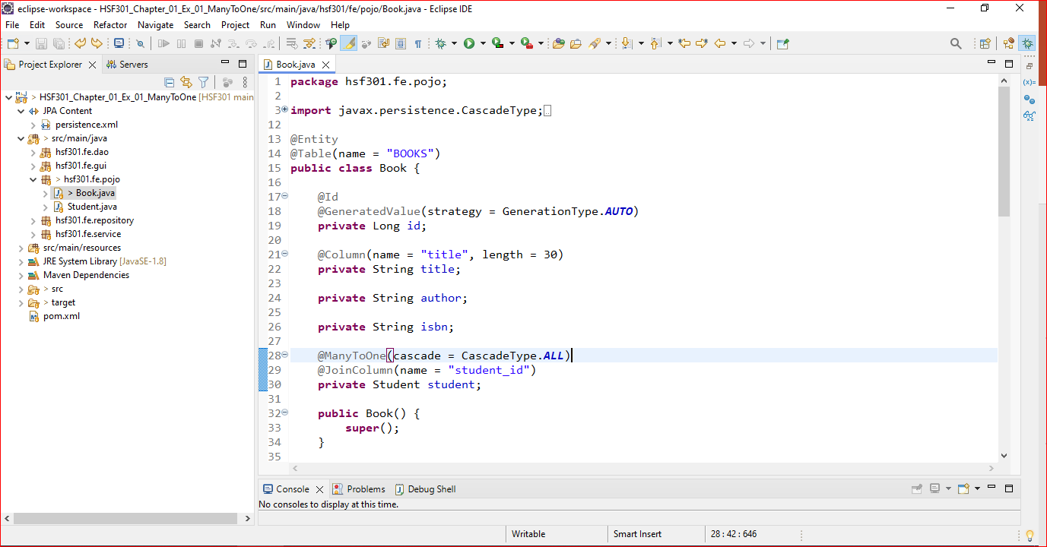
7. Create Books in Pojo

Slide 54
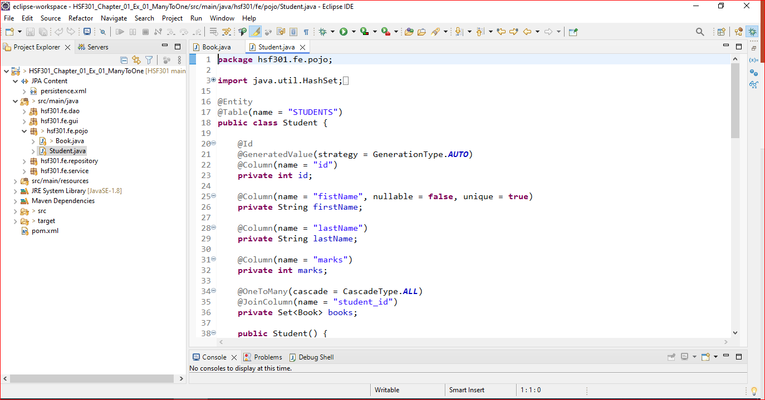
8. Create Students in Pojo

Slide 55
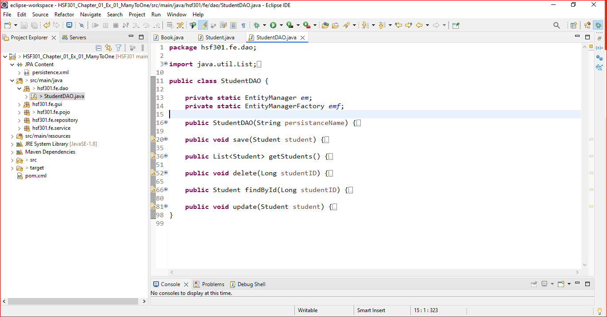
9. Create StudentDAO

Slide 56
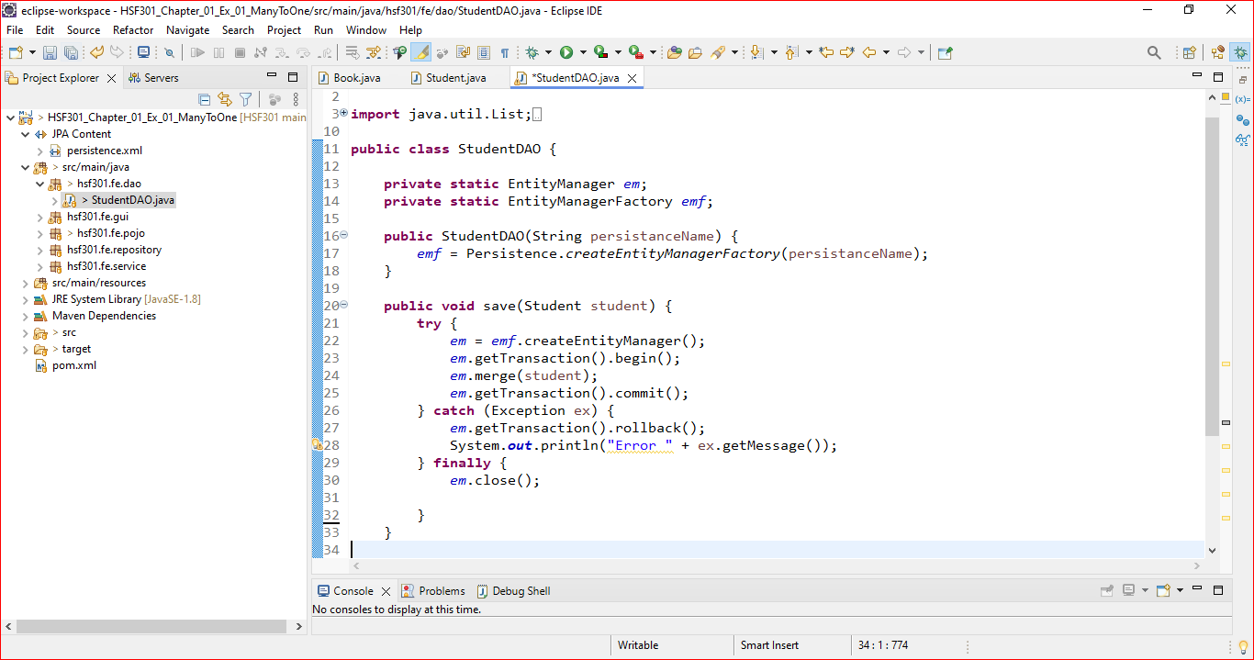
10. Save Student in StudentDAO

Slide 57
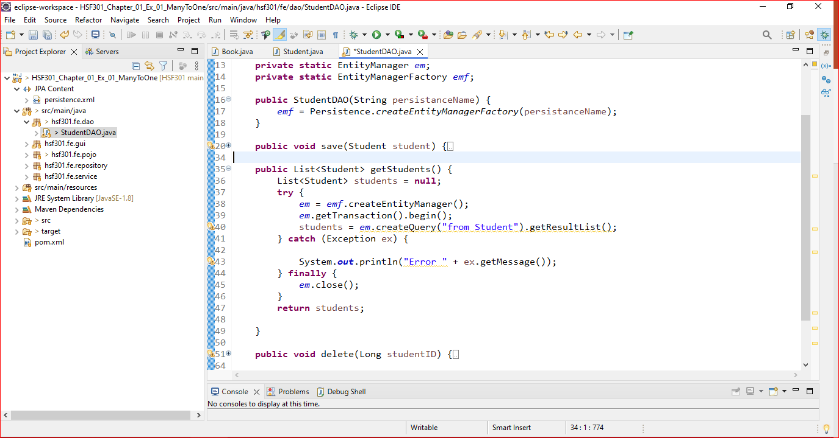
11. Get All Students in StudentDAO

Slide 58
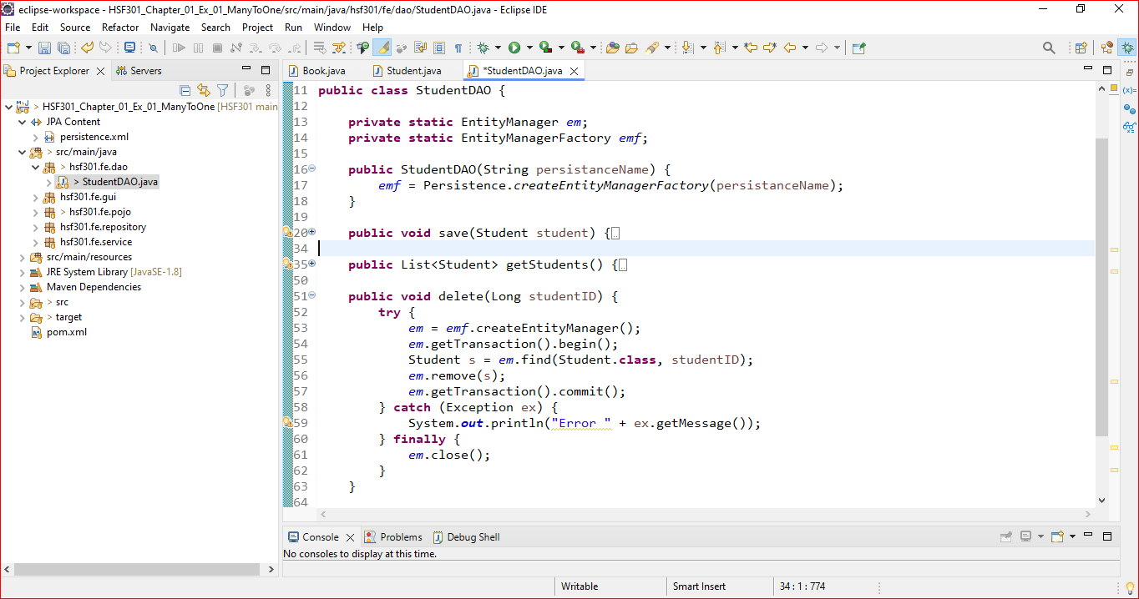
12. Delete Student in StudentDAO

Slide 59
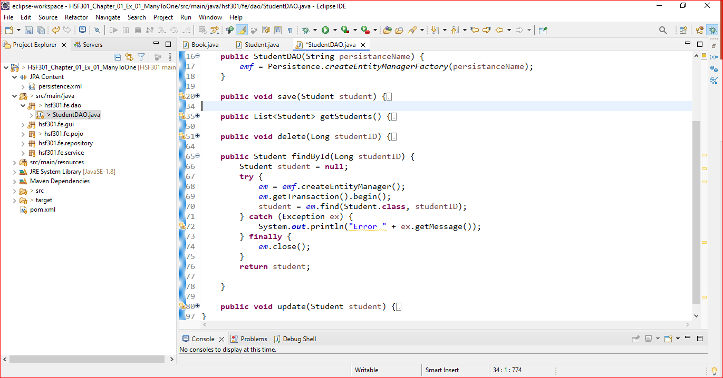
13. Get a Student in StudentDAO

Slide 60
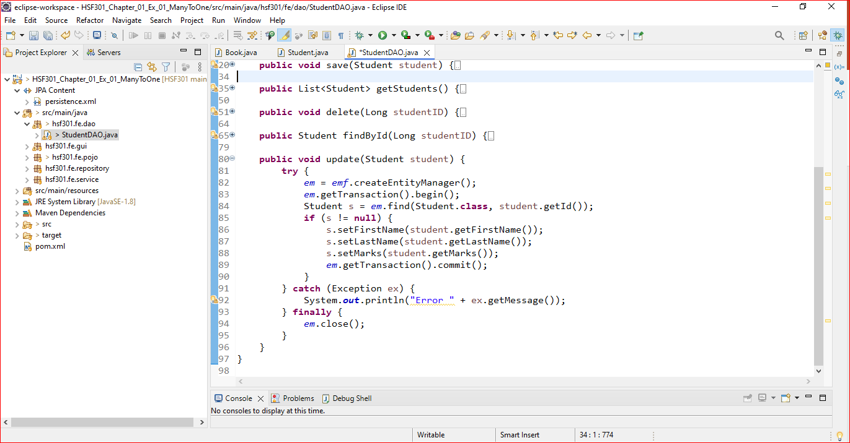
14. Get a Student in StudentDAO

Slide 61
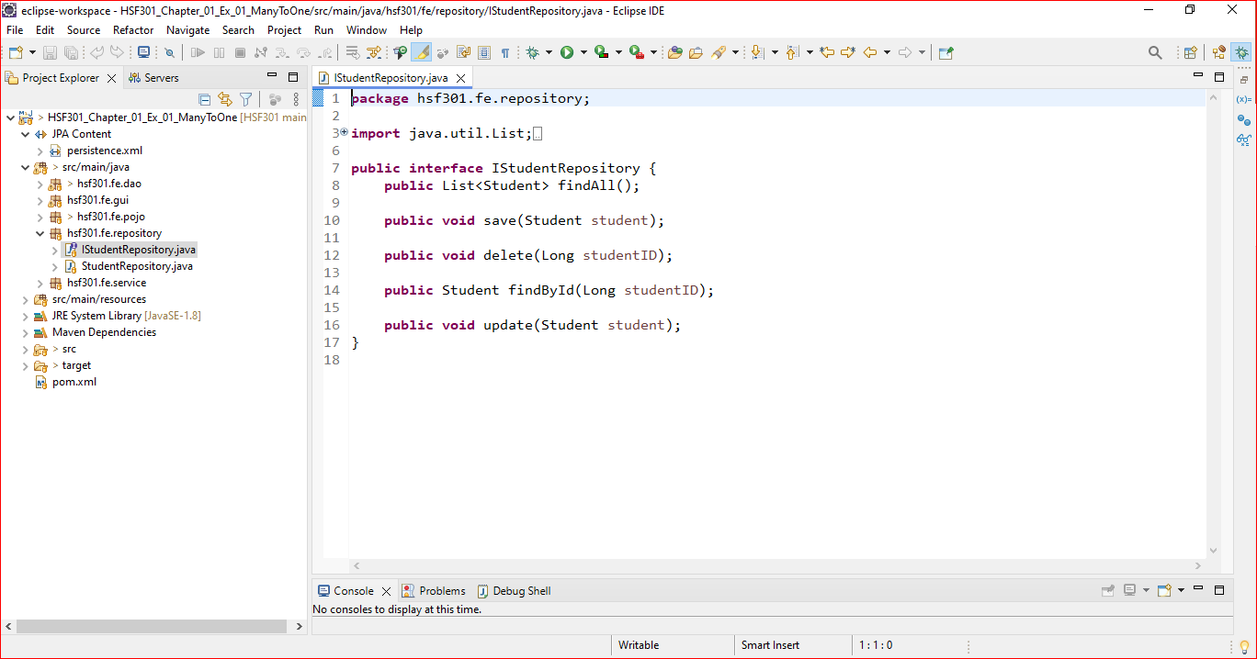
15. Create IStudentRepository

Slide 62
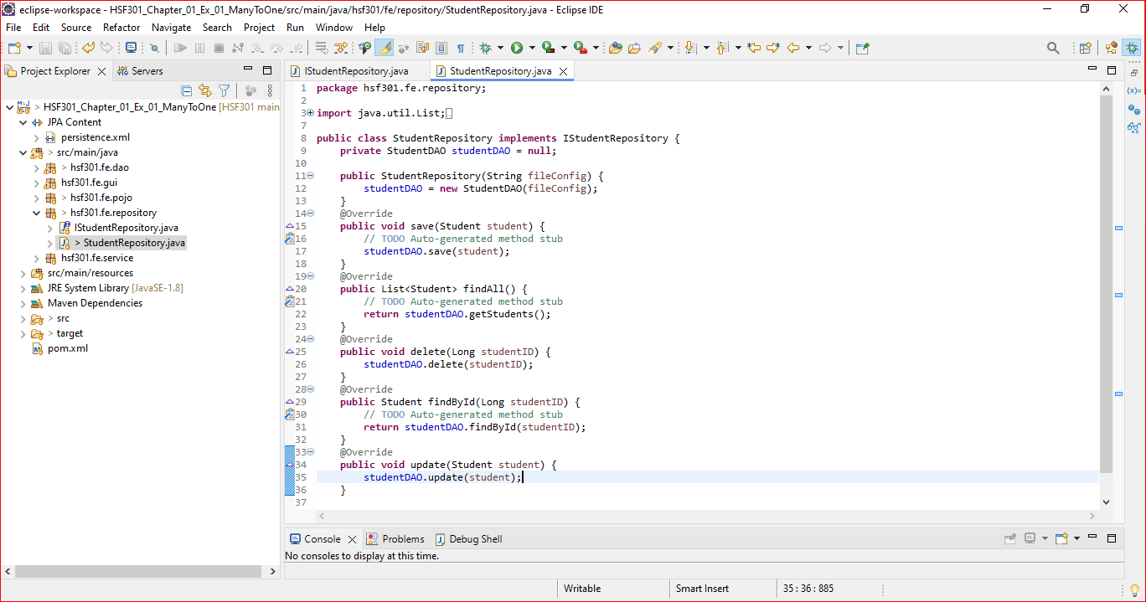
16. Create StudentRepository

Slide 63
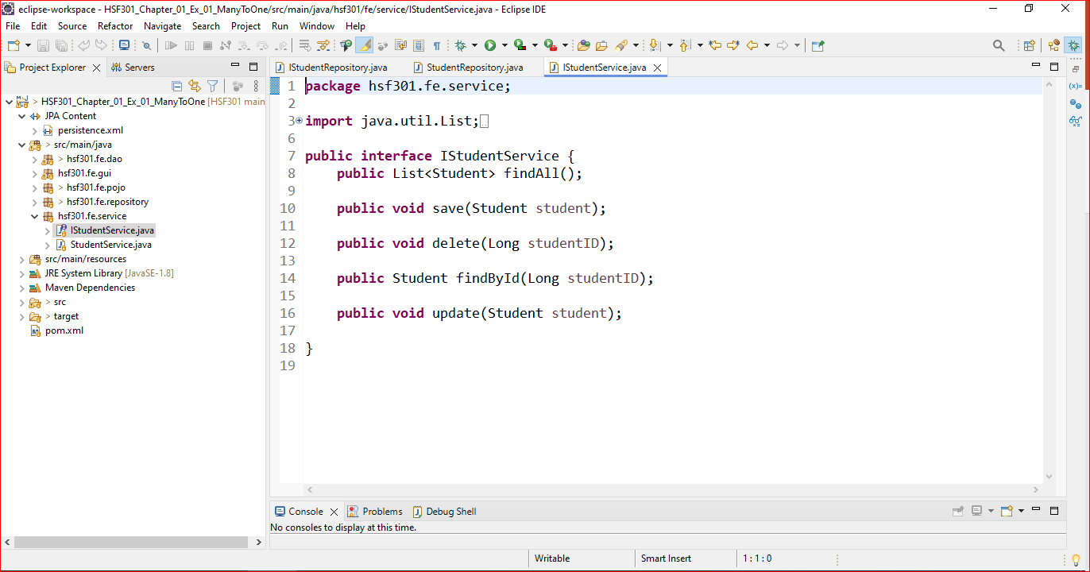
17. Create IStudentService

Slide 64
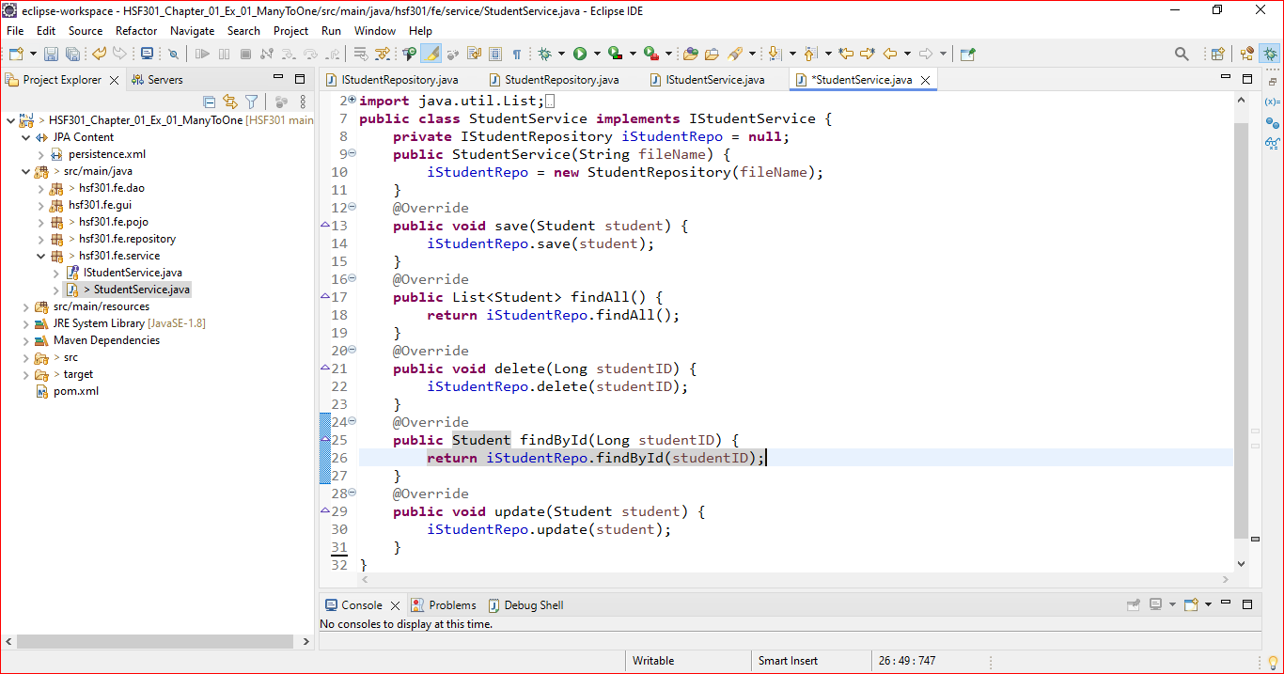
18. Create StudentService

Slide 65
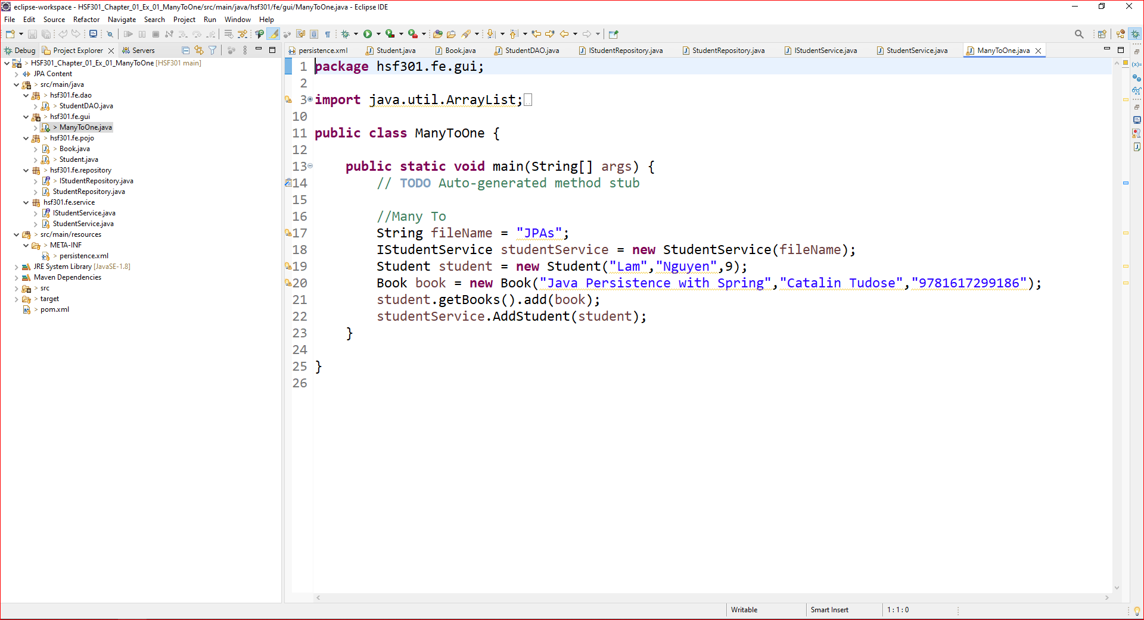
19. Create Main function

Slide 66
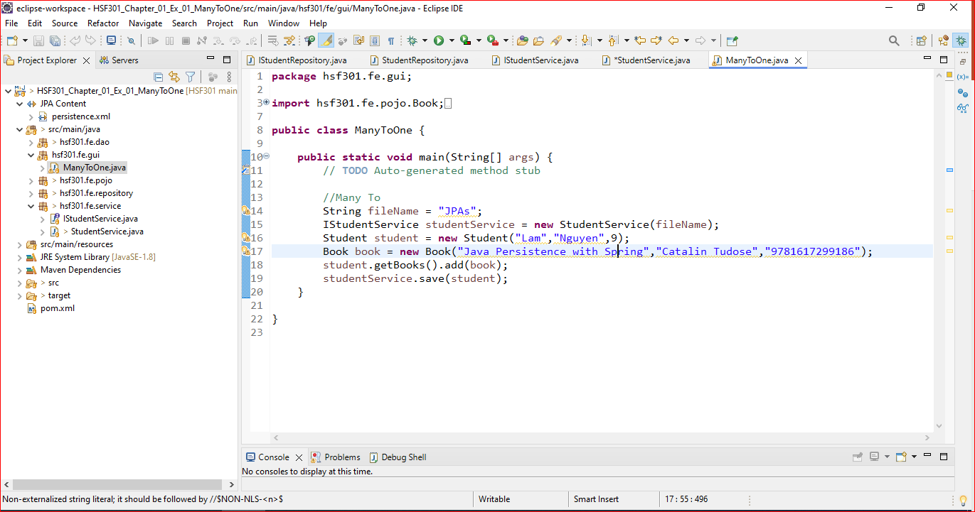
20. Run Program

Slide 67
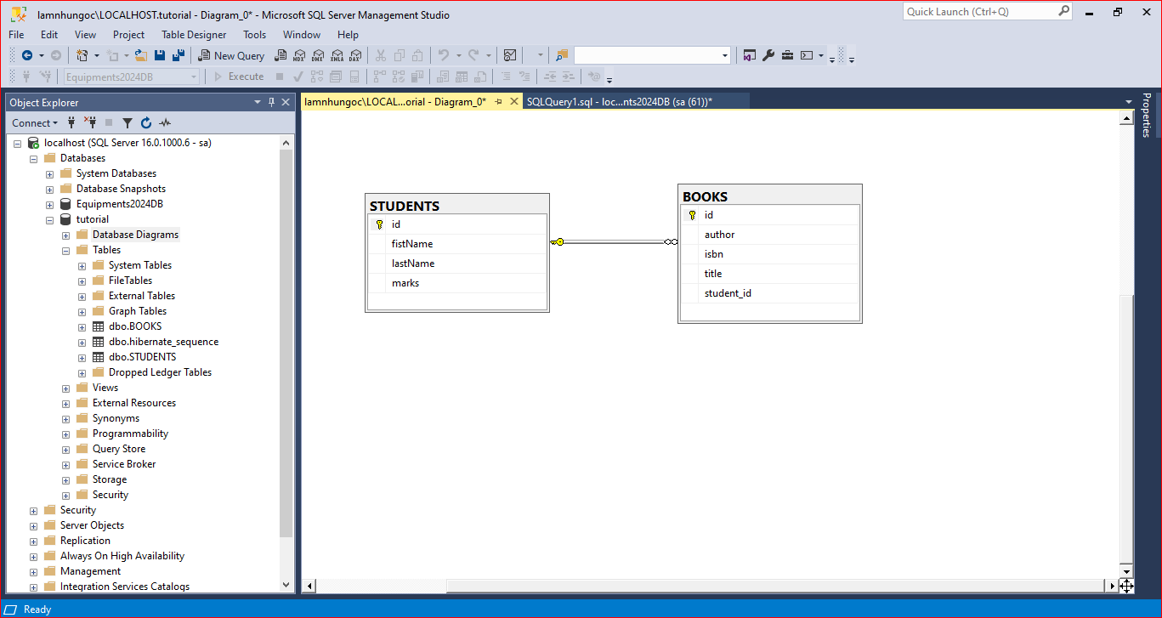
21. Result

Slide 68
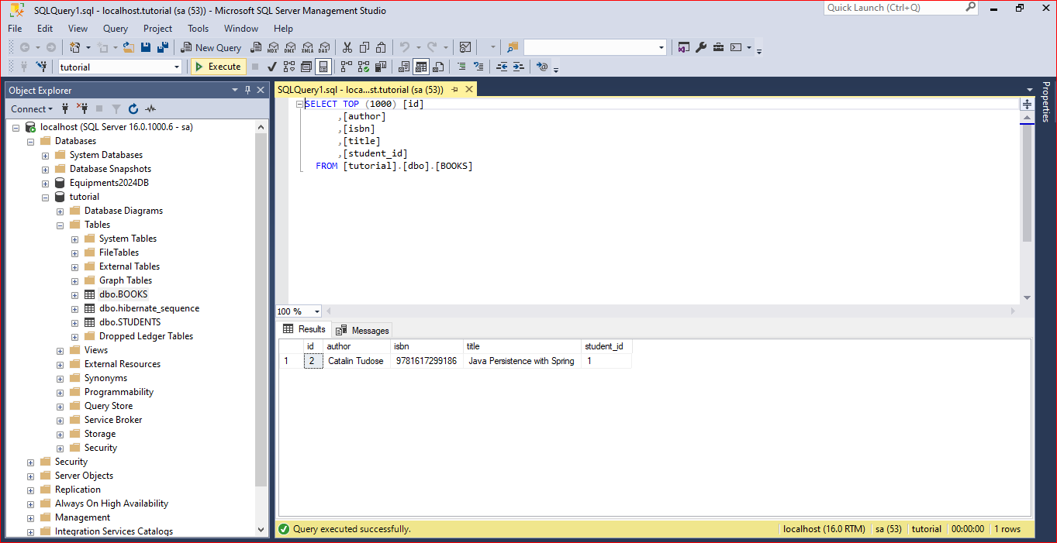
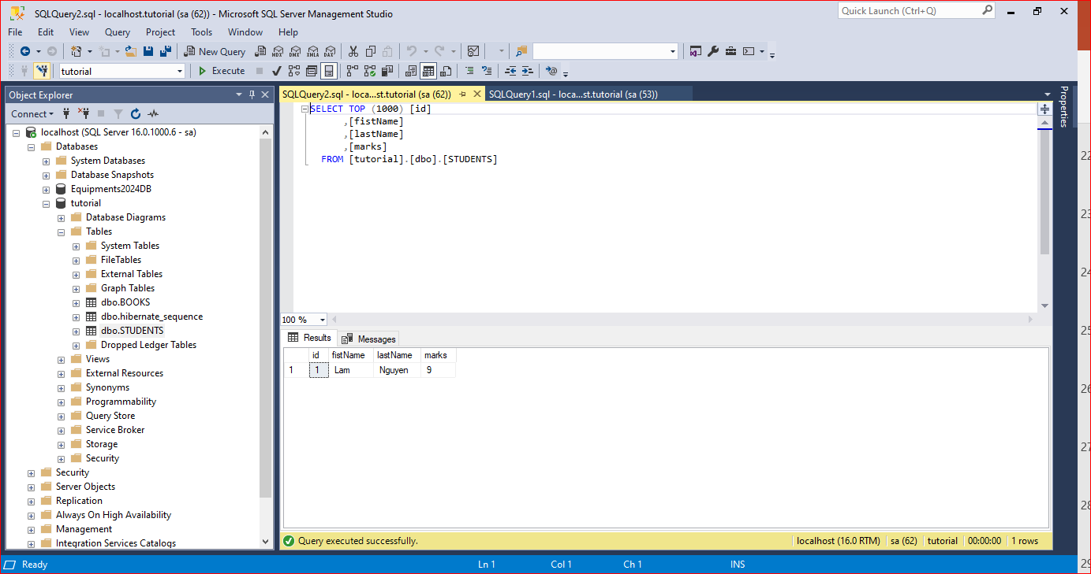
22. Result

Slide 69
Demo JPA (Many To Many)

Slide 70
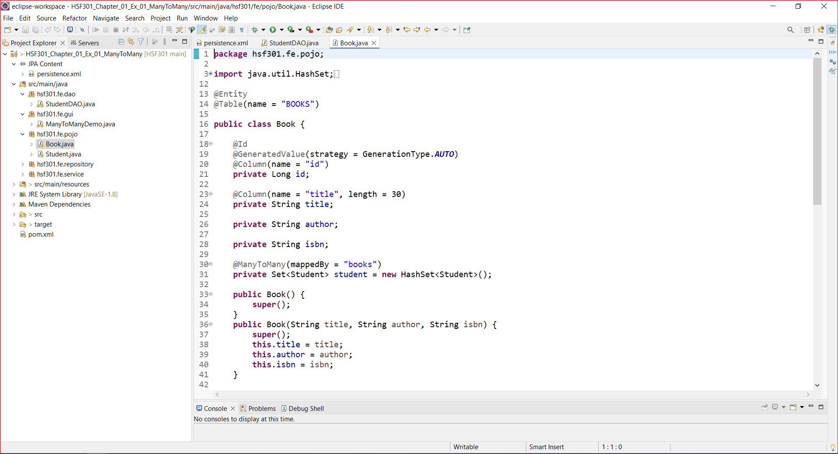
1. Create Books in Pojo’s Package

Slide 71

2. Create Students in Pojo’s Package

Slide 72

3. Run Program

Slide 73

4. Result

Slide 74

5. Result

Slide 75
Summary
Concepts were introduced:
Overview about JPA
Architecture Overview new features of JPA
Why JPA is selected as develop application?
Explain and demo using Eclipse IDE to create JPA Console App
Create and Run cross-platform Console application with Java connect to MSSQL with Repository Pattern

